Slide 1
18ECO133T Sensors and Transducers 3 Credit Course UNIT II

Slide 2
BOOKS 1. Patranabis, D., “Sensors and Transducers”, 2nd Edition, Prentice Hall India Pvt. Ltd, 2010. 2. Doeblin, E.O., “Measurement Systems: Applications and Design”, 6thEdition, Tata McGraw-Hill Book Co., 2011. 3. Bentley, J. P., “Principles of Measurement Systems”, 4th Edition, Addison Wesley Longman Ltd., UK, 2004. 4. Murthy, D.V.S., “Transducers and Instrumentation”, Prentice Hall of India Pvt. Ltd., New Delhi, 2010. 5. Neubert H.K.P., “Instrument Transducers – An Introduction to their performance and Design”, Oxford University Press, Cambridge, 2003.

Slide 3
Unit iI
Introduction to Inductive sensor
Sensitivity and linearity of the sensor
Transformer type transducer
Electromagnetic transducer
Magnetosrtictive transducer
Materials used in inductive sensor
Mutual Inductance change type
LVDT: Construction-Material, input output relationship
Synchros-Construction
Capacitive sensor
Introduction-Parallel plate capacitive sensor
Variable thickness dielectric capacitive sensor
Electrostatic transducer-Piezoelectric elements
Ultrasonic Sensors-Calculation of sensitivity
Capacitor microphone, response characteristics

Slide 4
Introduction to Inductive Sensor Basic Concept
Uses the principle of electromagnetic induction to detect or measure objects
An inductor develops a magnetic field when a current flows through it; alternatively, a current will flow through a circuit containing an inductor when the magnetic field through it changes. This effect can be used to detect metallic objects that interact with a magnetic field.
Non-metallic substances such as liquids or some kinds of dirt do not interact with the magnetic field, so an inductive sensor can operate in wet or dirty conditions.

Slide 5
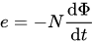
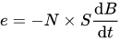
The inductive sensor is based on Faraday's law of induction.
The temporal variations of the Magnetic Flux through a N turns circuit will induce a voltage e which follows:
which can be expressed in a simpler way:
by assuming that the induced magnetic field B is homogeneous over a section S (the Magnetic flux will be expressed =B X S

Slide 6
One form of inductive sensor drives a coil with an oscillator.
A metallic object approaching the coil will alter the inductance of the coil, producing a change in frequency or a change in the current in the coil.
These changes can be detecte, amplified, compared to a threshold and use to switch an external circuit.
The coil may have a ferromagnetic core to make the magnetic field more intense and to increase the sensitivity of the device.
A coil with no ferromagnetic core ("air core") can also be used, especially if the oscillator coil must cover a large area.
Another form of inductive sensor uses one coil to produce a changing magnetic field, and a second coil (or other device) to sense the changes in the magnetic field produced by an object, for example, due to eddy currents induced in a metal object

Slide 7
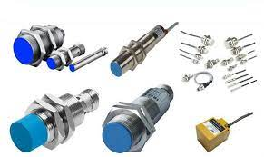
Types of Inductive Sensor

Slide 8
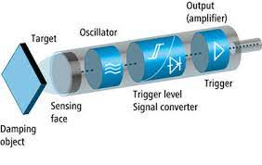
Technology in inductive Sensor

Slide 9
APPLICATIONS
Search coil magnetometer
Inductive proximity sensor
Metal detectors
Traffic lights
Car washes
Many automated industrial processes.
The sensor does not require physical contact it is particularly useful for applications where access presents challenges or where dirt is prevalent

Slide 10
Reluctance-the opposition offered in a magnetic circuit to magnetic flux
Mutual Inductance-When two coils are brought in proximity with each other the magnetic field in one of the coils tend to link with the other. This further leads to the generation of voltage in the second coil. This property of a coil which affects or changes the current and voltage in a secondary coil is called Mutual Inductance
Eddy currents - are loops of electrical current induced within conductors by a changing magnetic field in the conductor according to Faraday's law of induction

Slide 11
The two most common methods of achieving variation in inductance are
(i) by changing the reluctance of the magnetic path and
(ii) by coupling two or more elements.
The latter technique works by
(a) change of mutual inductance,
(b) change of eddy current when one element is just a
short-circuited sleeve, and
(c) transformer action

Slide 12
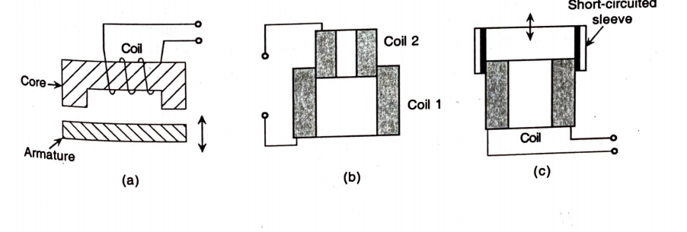
(a) change of reluctance of magnetic path, (b) change of mutual inductance between two coils, (c) change of mutual inductance between a coil and a sleeve,

Slide 13
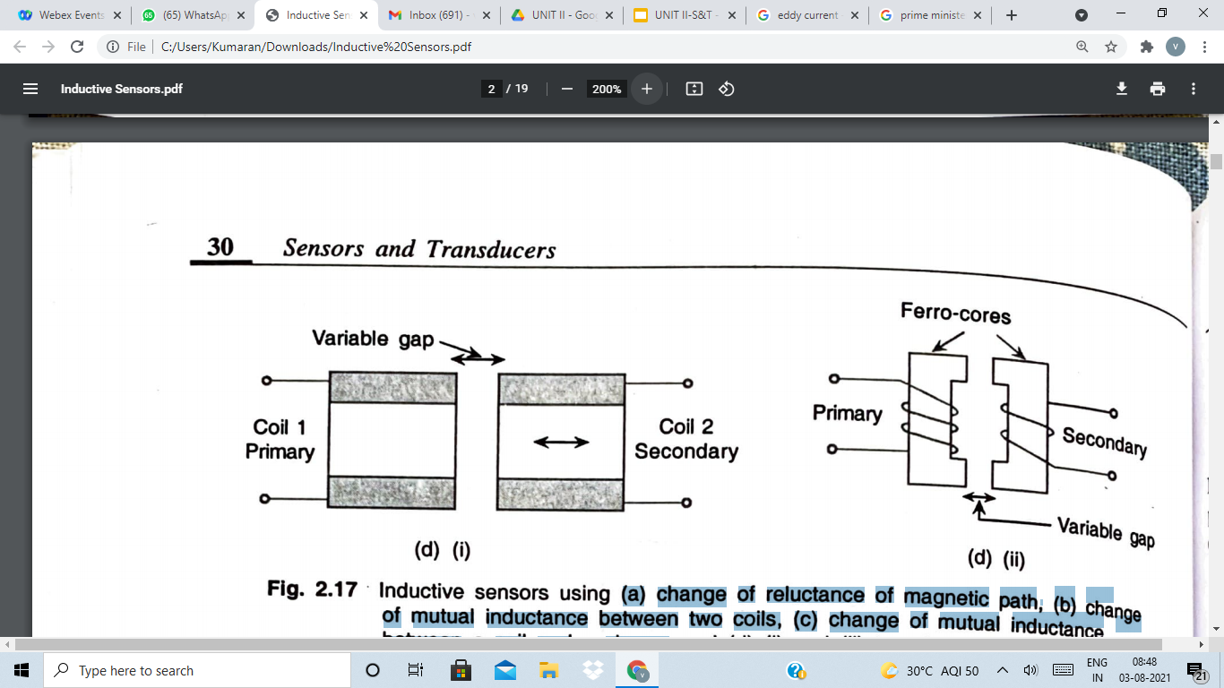
(d) (i) and (ii) transformer action

Slide 14
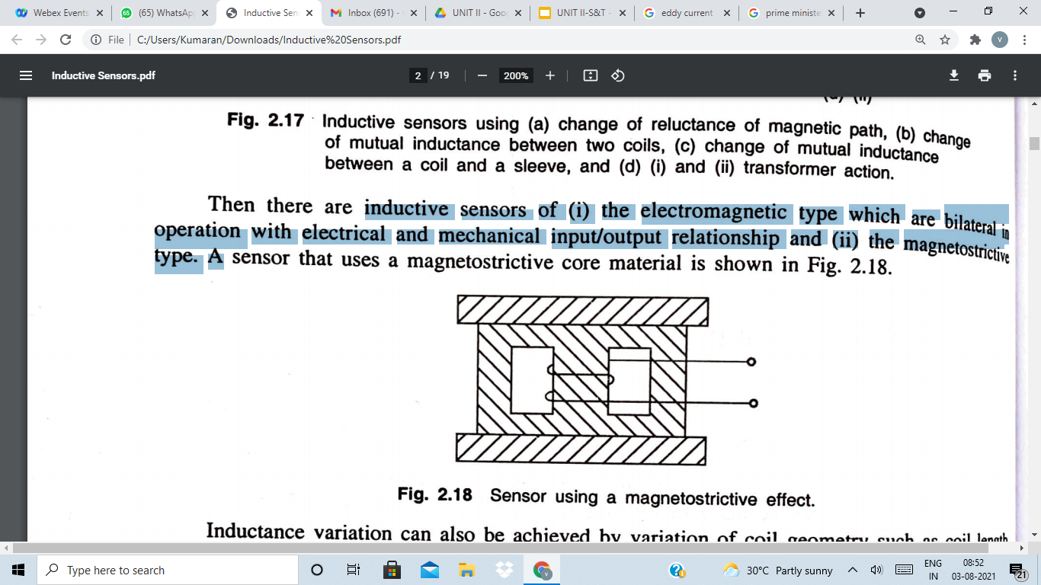
Types
Inductive sensors of
(i) the electromagnetic type which are bilateral in operation with electrical and mechanical input/output relationship and (ii) the magnetostrictive Type

Slide 15
A coil is an essential part of inductive transducers
The coil may be wound on a metal (iron) core or an air core.
In the variable reluctance type,
the core is a ferromagnetic material as also the armature.
This type of sensors are, perhaps, the most extensively used because it (i) is the most sensitive one, (ii) is least affected by external fields as the air gap is least, and (iii) requires less number of turns than in air core design for same value of inductance so that interwinding or self-capacitance and stray effects are less.

Slide 16
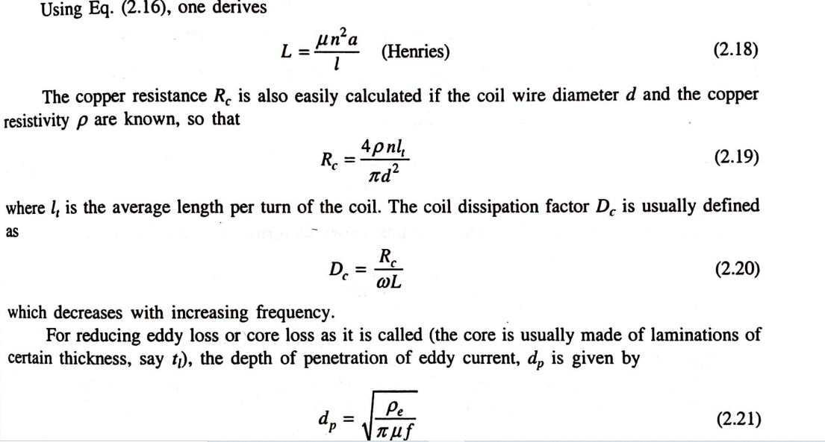

Slide 17
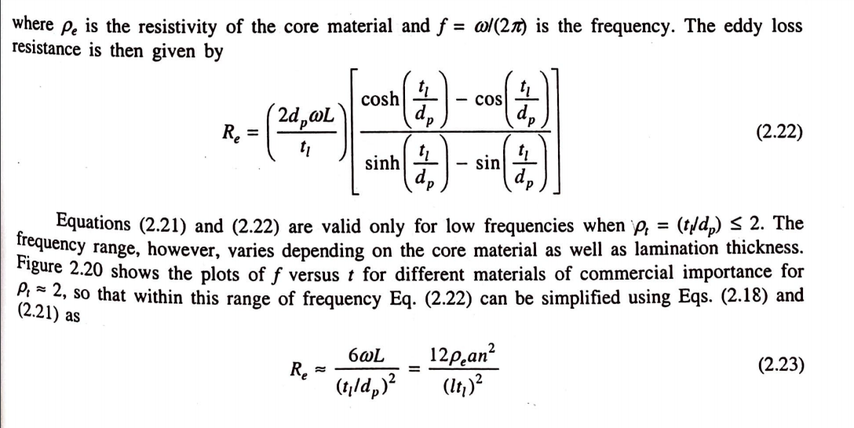

Slide 18
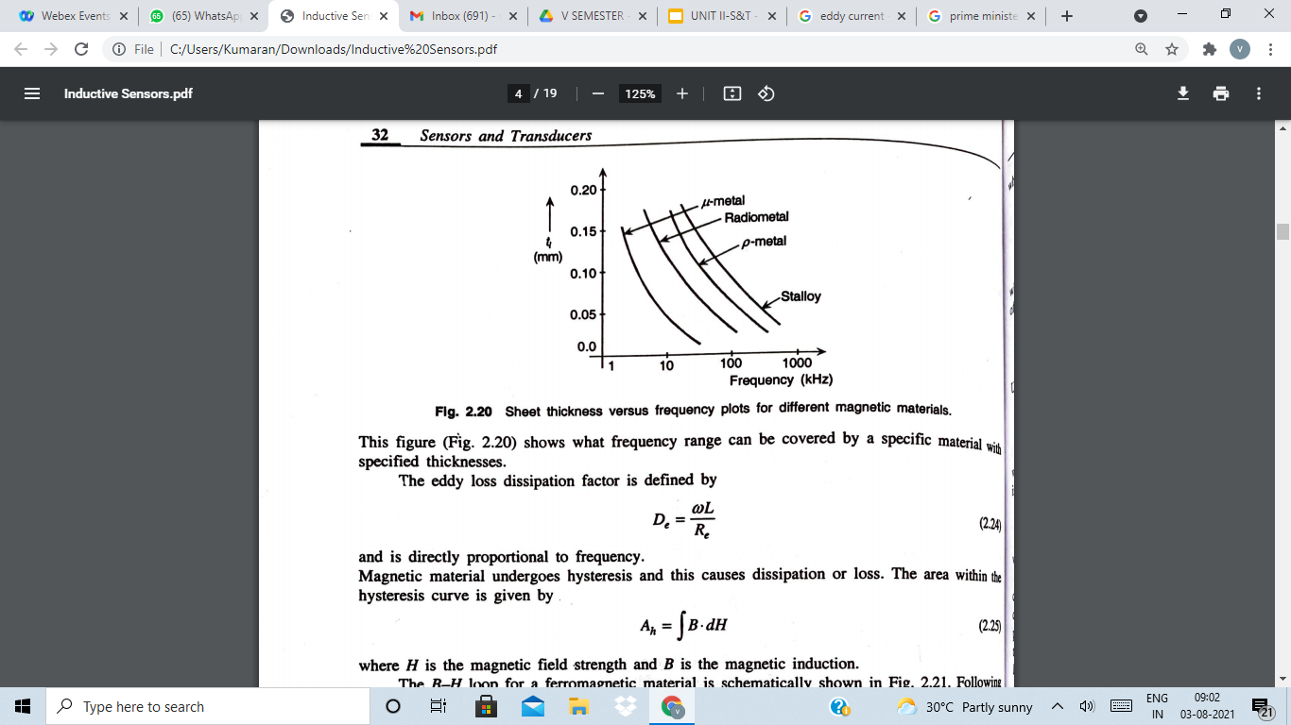

Slide 19
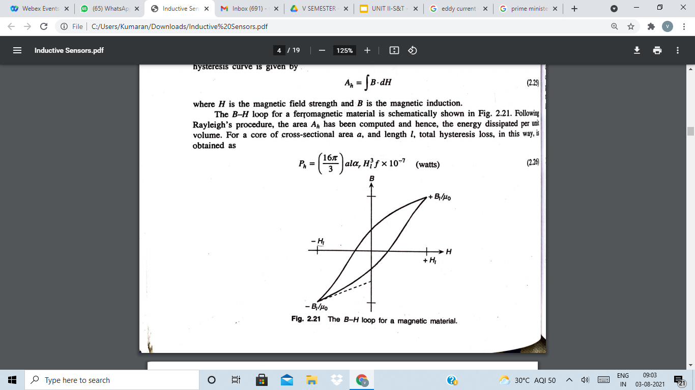

Slide 20
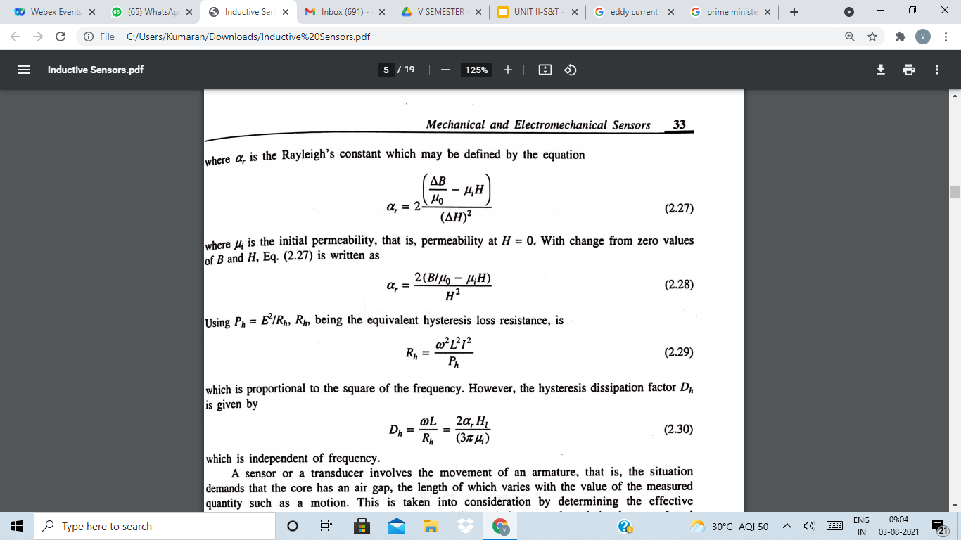

Slide 21
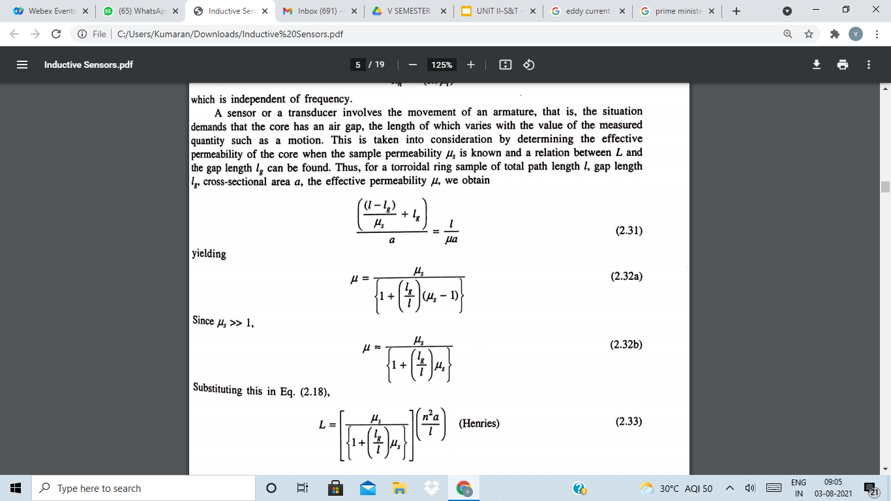

Slide 22
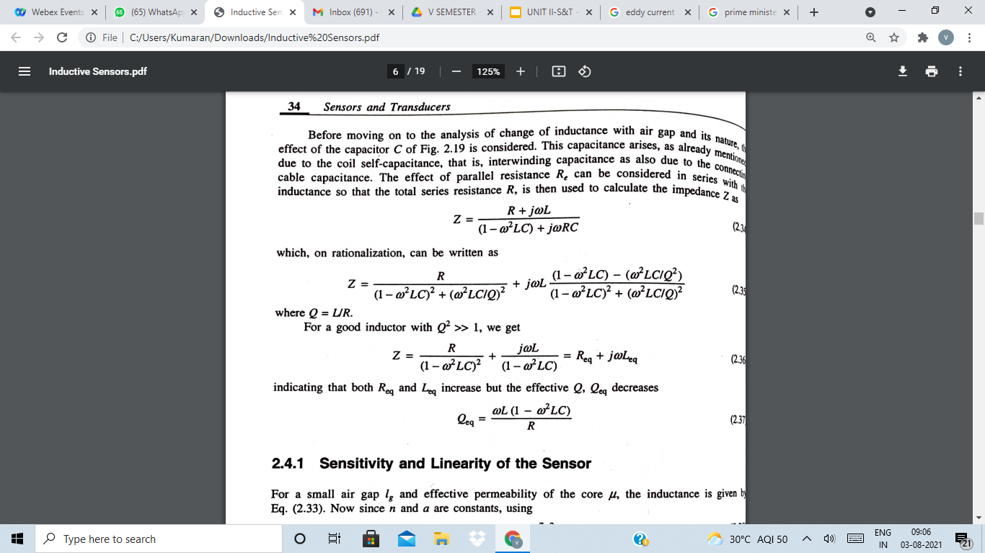

Slide 23
For transformer type transducer , refer the pdf
For electromagnetic type transducer , refer the pdf
https://www.youtube.com/watch?v=zyJZJu_1lgE -LVDT
https://www.youtube.com/watch?v=N20lO9cWL9w -- lecture series I on sensor and transducer
https://www.youtube.com/watch?v=s2o600RiEGU - LVDT

Slide 24
Electromagnetic Transducer
Bilateral double-function type transducer('mechanical input-electrical output' and 'electrical input-mechanical output)
These transducers can be used both as 'generators' and 'sensors' often termed as 'senders' and 'receivers' respectively
Governed by (i) Faraday's law of electrodynamics and (ii) piezoelectric effect
Consists of an inductance coil wound on a ferromagnetic core and a variable gap provides the variation in the output.
For producing unidirectional flux, a magnetizing coil with a bias current may be provided or the core
Generally, a permanent magnet is used as a core

Slide 25
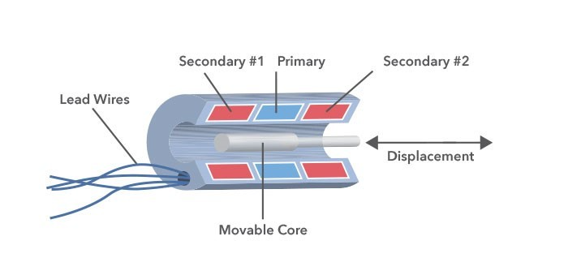
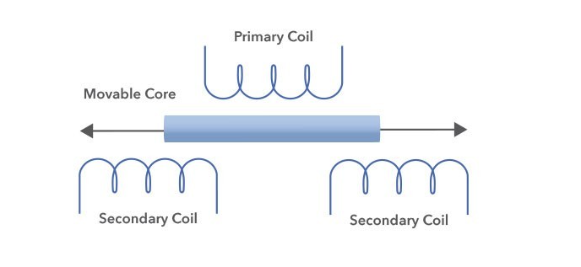
LVDT

Slide 26

LVDT/RVDTS CAN PROVIDE ABSOLUTE POSITIONING IN HARSH ENVIRONMENT APPLICATIONS.
LVDT application

Slide 27

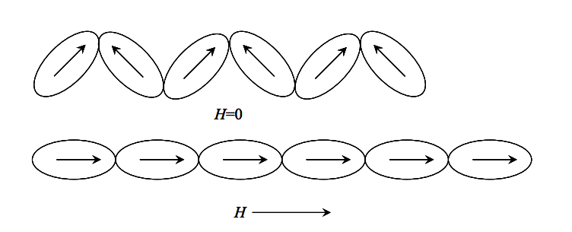
What is Magnetostriction?
Magnetostriction is a property of ferromagnetic materials that causes them to change their shape or dimensions (expand or contract) during the process of magnetization.
The effect was first identified in 1842 by James Joule when observing a sample of nickel.

Slide 28



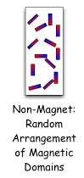
Magnetostriction - Working
Internally, ferromagnetic materials have a structure that is divided into domains, which are randomly oriented when the material is not exposed to a magnetic field and each domain is a region of uniform magnetic polarization.
When a magnetic field is applied, the boundaries between the domains shift and the domains rotate; both of these effects cause a change in the material’s dimensions.

Slide 29

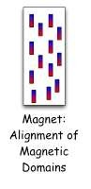
Result of Magnetostriction
The orientation of these small domains by the imposition of the magnetic field creates a strain field.
As the intensity of the magnetic field is increased, more and more magnetic domains orientate themselves so that their principal axes of anisotropy are collinear with the magnetic field in each region and finally saturation is achieved.

Slide 30

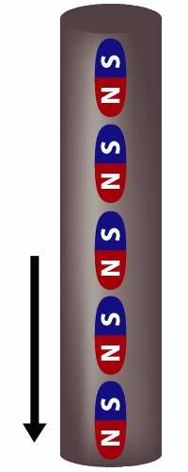









Effect of increasing and decreasing applied or external magnetic field(H) on a ferromagnetic material can be seen here.
The arrow mark indicates the change in value (increase or decrease) and direction of applied magnetic field.

Slide 31
Magnetostrictive Transducer
Magnetostrictive position sensors are non-contact linear position sensors
They use the momentary interaction of two magnetic fields to produce a strain pulse that moves along a waveguide. One field is from a magnet that moves along the outside of the waveguide. The other field is from the waveguide itself.
Magnetostrictive position sensors a unique signal for each point along the axis of travel.
The advantage to this type of sensor is that it is non-contact and there is no wear or friction. It is also not affected by vibrations so there is no limit on the number of operating cycles.
The disadvantage is the dead band on both sides of the sensor which cannot be reduced to zero.

Slide 32
Magnetostrictive Transducer
It is not popular because of its limitations with respect to materials
Types:
(a) Variable permeability type (b) Variable remanence type
In general slope of hyteresis curve decreases with increasing tension-this changes the value of permeability-hence inductance of the coil wound on the material
With increasing tension the remanence magnetism B0 decreases(e.g. Ni is with negative magnetsriction.

Slide 33
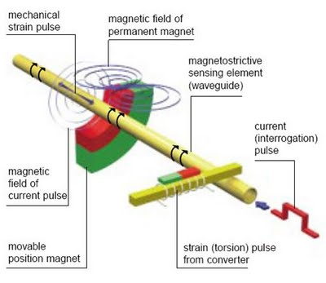
Magnetrostriction is a property of ferromagnetic materials to expand or contract when placed in a magnetic field. T
The sensor senses the position of the permanent (position) magnet to determine the distance between the permanent magnet and the sensor head.
There are five main components of the magnetostrictive sensor: Waveguide, position magnet, electronics, strain pulse detection system, and damping module.

Slide 34
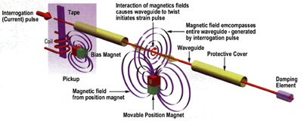
Typically, the waveguide wire is enclosed within a protective cover and attached to the device that is being measured.
Applying a current pulse generates a sonic wave that travels along the waveguide to a small piece of magnetostrictive material that passes through a coil and is magnetized by a small, permanent magnet.
The stress induced by the sonic wave causes a wave of changed permeability in the magnetostrictive material, resulting in a change in its magnetic flux and the production of voltage output from the coil.
Electronic circuitry detects the voltage pulse and conditions it into the desired output.
At the sensor rod tip, at the end opposite the head, there is an unusable area called the dead zone. The system must be designed so that the front face of the position magnet will come no closer to the tip than the specified dead zone distance.

Slide 35
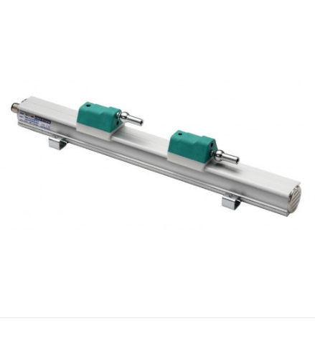
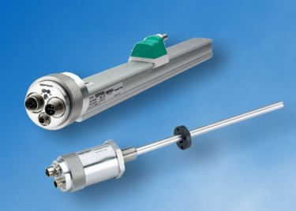
Magnetostrictive Transducer

Slide 36
Applications
Magnetostrictive transducers are used for position measurement.
The sensors are used to measure the stroke of hydraulic cylinders.
Industrial application
Installation in hydraulic cylinders.
Packing machines, plastic machines, steel rolls or in beverage bottling plants.

Slide 37
Magnetostrictive Transducer
https://www.youtube.com/watch?v=R9CAmjVK3SI Magnetostrictive technology
https://www.youtube.com/watch?v=YFq94BpWGEE

Slide 38
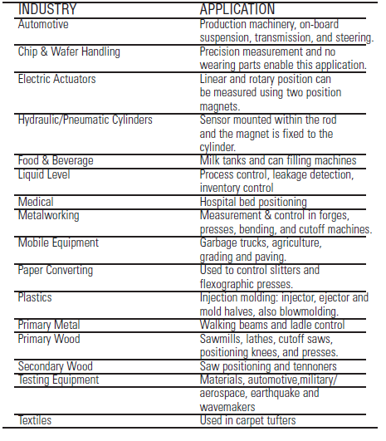

Slide 39
Materials
Permeability, Hysteresis loss, Curie temperature, Eddy current loss
Core and Armature- Ferromagnetic material- High permeability, low loss, high curie temperature, low cost
Soft magnetic Ni-Fe alloy is good- commercial variety-
Mu metal (permeability varies from 60X10^3 to 240x10^3 ,Hysteresis loss- 4 & Curie temperature 350 degree)and Radimetal (permeability varies from 4X10^3 to 65x10^3 ,Hysteresis loss- 40 & Curie temperature 540 degree)

Slide 40
https://www.youtube.com/watch?v=DyI7OieCbxs

Slide 41
Basic principle-synchro
Synchros are electromechanical devices which produce an output voltage depending on angular position of the rotor and not on rotor speed and it is different from a DC generator.
The trade name for Synchros are Selsyn, Antosyn and Telesyn.
Synchros are used primarily for the rapid and accurate transmission of information between equipment and stations.
Examples of such information are changes in course speed and range of targets or missiles; angular displacement (position) of the ship's rudder; and changes in the speed and depth of torpedoes
(Note: A modern torpedo is an underwater ranged weapon launched above or below the water surface, self-propelled towards a target, and with an explosive warhead designed to detonate either on contact with or in proximity to the target).

Slide 42
Basic principle-synchro
Synchros, are simply variable transformers.
They differ from conventional transformers by having one primary winding (the rotor), which may be rotated through 360º and three stationary secondary windings (the stator) spaced 120º apart.
It follows that the magnetic field within the synchro may also be rotated through 360º.
If an iron bar or an electromagnet were placed in this field and allowed to turn freely, it would always tend to line up in the direction of the magnetic field.
This is the basic principle underlying all synchro operations.

Slide 43
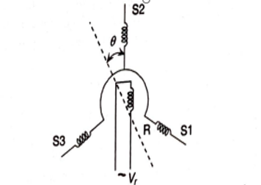
Constructional Feature of a Synchro

Slide 44
Synchros –Construction
By changing the magnetic coupling between coils, ac-excited electromechanical sensors have been developed.
For measurement at distant points, such devices are adopted and are known as synchros.
Synchros, as sensors, are of two types, namely (i) torque type and (ii) control type.
The general constructional features of a synchro are represented in figure
It consists of a stator with three windings S1,S2 and S3 separated by 120 degree in space and a rotor R, which is supplied with an ac voltage .

Slide 45
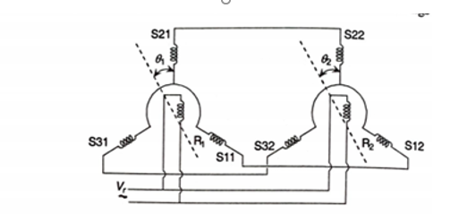
torque type Synchro sensor

Slide 46
torque type syncro sensor
A rotation of the rotor R1 by an angle θ changes the voltages induced into the stator windings S11,S21 and S31 in magnitude and phase.
And since these windings are connected electrically to S12,S22 and S32 same voltages with phases as in those of windings of stator 1 produce a field so that rotor R2.
If not oriented as rotor R1 would receive a torque and rotation till it attains the same rotational position as that of R1.
With a scale arrangement the rotated angle thus produced, may be measured.
For single synchro unit such as that Fig 4.45 with the rotor angle θ for an input sinusoidal voltage V_{r}=V_{ro} sinω t , the voltages induced in windings S1 and S2 and S3 are

Slide 47
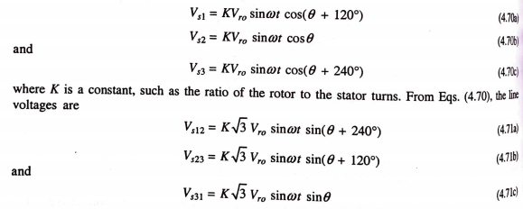

Slide 48
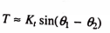
If θ=0⁰ ,V_{s2}=KV_{ro} sinωt that is a maximum and V_{s31} = 0.
This position of the rotor is marked as the zero position or the reference position.
In torque type sensors, it is tacitly assumed that θ₁=θ₂ .In such a situation there is no compensation current because of any unbalanced terminal voltages.
If however θ_{1 ≠} θ₂ a torque would be produced on the receiver synchro rotor till the equality is achieved.
The torque is approximately sinusoidal in form
maximum torque occurs at θ_{1 ~} θ₂ = 90⁰
For θ₂ approaches θ₁ that is θ₁ - θ₂ being small, torque versus
(θ₁ - θ₂ ) curve is approximately linear

Slide 49
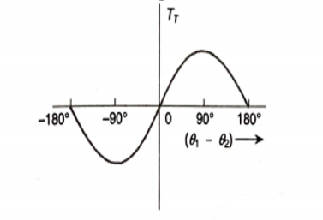
Torque angle Characteristics Curve

Slide 50
Capacitive Sensor
A capacitive sensor will react to an object acting as a dielectric material as well as a conductive object.
Inductive sensors use a magnetic field to detect objects. Capacitive sensors use an electric field. In order to be sensed by an inductive sensor an object must be conductive
Capacitive sensors are used for detecting a range of objects, from non-conductive and conductive material, to tiny objects, like insects, and larger ones, like a human. Using capacitance, sensing brings many advantages compared to other sensing technology.

Slide 51
Capacitive Sensor-types
1.Variable capacitance type with varying distance between two or more parallel electrodes
2.Variable capacitance obtained by variable area between the electrodes. An interesting variation of this is obtained by making serrated electrodes or electrodes with teeth, one of which moves
3. Variable capacitance obtained by having variable dielectric constant of the intervening material. For this the material has to move between the pair of electrodes, and the change in capacitance is obtained and measured
4. Piezoelectric type, depends on the piezoelectric properties of specific kinds of dielectric materials

Slide 52
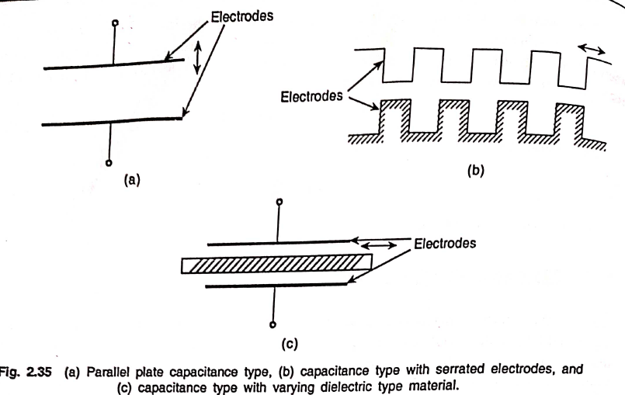
Capacitive Sensor-types

Slide 53
Capacitive Sensor
A variation in parallel type design is the cylindrical design.
Besides, the parallel plate capacitive sensor is often used in a differential form with three plates as shown in a Figure
For a parallel plate capacitor with dielectric constant or permittivity ᵋ , which is the product of its relative permittivity and the permittivity of the free space (vacuum, often taken as air) of value 8.85 x 10⁻¹² F/m and plate area a, each separated by a distance x from the other, the capacitance is
Cp= ᵋᵅ/x

Slide 54
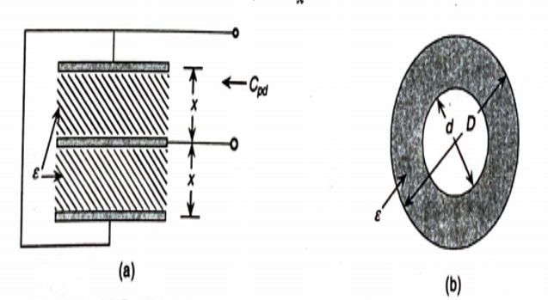
Capacitive Sensor a. Parallel plate capacitive sensor-3 plates, b. cylindrical type

Slide 55
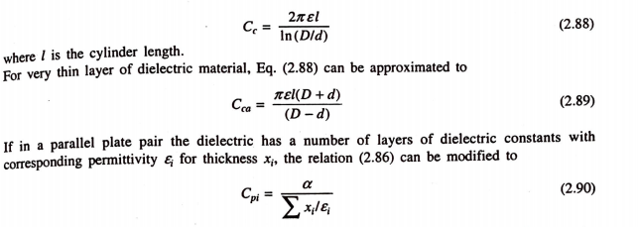
Capacitive Sensor

Slide 56
Capacitive Sensor
The capacitance is, in general, associated with a high resistance, called leakage, because the dielectric materials do not have infinite permittivity.
This leakage is represented by a parallel resistance Rp, particularly at lower frequencies of measurement.
This loss consists of dc conductance, dielectric loss of insulators supporting the electrodes, and the actual dielectric loss.
With increasing frequency, the load resistances R_{l} contribute to loss factors and the complete equivalent circuit is given by the circuit , where the inductance L represents the inductance between the terminals as also the cable inductance whenever such cable is used.

Slide 57
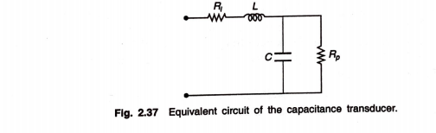
Capacitive Sensor

Slide 58
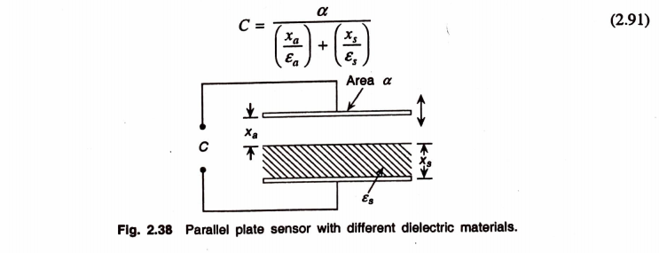
Parallel plate Capacitive Sensor
Considering now a general case of a pair of parallel plates with a solid dielectric of a certain thickness x_{s} and an air gap x_{a} as shown, the capacitance C is given by

Slide 59
Parallel plate Capacitive Sensor
It must be stressed here that capacitors have fringing effects which are usually taken care of by providing guard ring which is a ring surrounding a plate of the capacitor, the ring and the plate both being at the same potential.(refer pdf)

Slide 60
Capacitive Sensor
https://www.youtube.com/watch?v=QItuf6lNvmI - capacitive sensor
https://www.youtube.com/watch?v=cFvh7qM6LdA - how do touch screen works?

Slide 61
What is Dielectric Capacitive sensor
Capacitance sensors (or Dielectric sensors) use capacitance to measure the dielectric permittivity of a surrounding medium.
TO Know Real time application!
One application for such a device is measuring the water content of soil, where the volume of water in the total volume of soil most heavily influences the dielectric permittivity of the soil because the dielectric of water (80) is much greater than the other constituents of the soil (mineral soil: 4, organic matter: 4, air: 1). When the amount of water changes in the soil, a probe will measure a change in capacitance due to the change in dielectric permittivity that can be directly correlated with a change in water content. Capacitance sensors are now widely used in irrigation scheduling in agriculture around the world

Slide 62
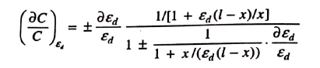
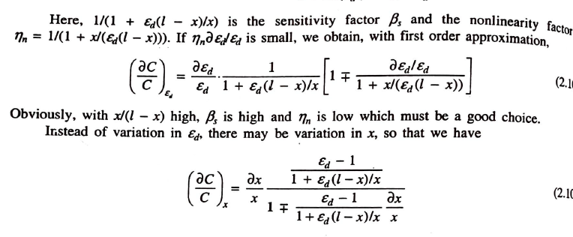
Cont…
The normalized change in Capacitance

Slide 63
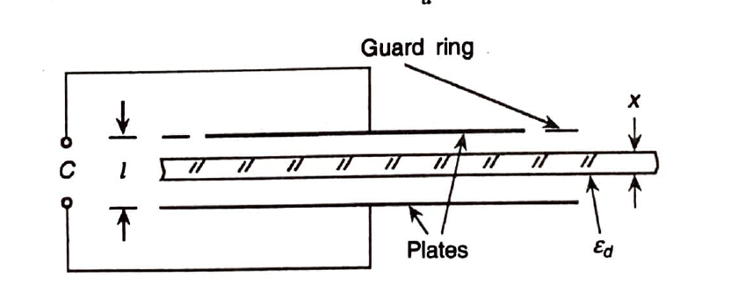
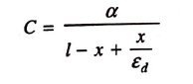
Variable thickness dielectric capacitive sensor
This type of capacitive sensors can be represented as shown below:
is plate effective area
C is Capacitance
is Permittivity of dielectric material

Slide 64
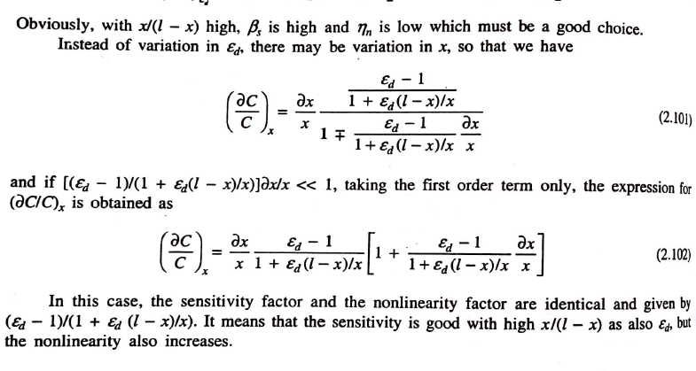
Cont…

Slide 65
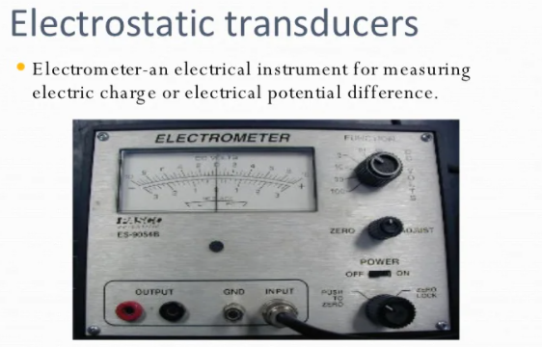
Electrostatic transducer
A transducer consisting of a fixed electrode and a movable electrode, charged electrostatically in opposite polarity; motion of the movable electrode changes the capacitance between the electrodes and thereby makes the applied voltage change in proportion to the amplitude of the electrode's motion.

Slide 66
Electrostatic transducer
https://www.youtube.com/watch?v=KGhFYSk4zJI -
Electrostatic Loudspeaker (ESL) Technology

Slide 67
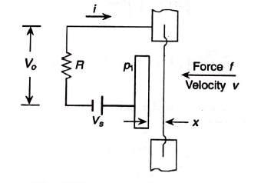
Electrostatic transducer
Similar to the electromagnetic transducer, capacitive type transducer can also be developed with bilateral characteristics, where it is used with dc polarization. Such a transducer is also referred to as an electrostatic transducer.
A capacitor is formed with a 'flexible' diaphragm which can move due to application of force and a rigid plate p_{1.} There is bias voltage V_{s} which is sufficiently large.

Slide 68
Cont…
When the system acts as a transducer, the gap x between the plates changes as by some pressure in case of an 'electrostatic microphone’.
This pressure may be considered sinusoidal in nature for analysis purpose.
A circuit consisting of a resistance R and capacitance C 'varying sinusoidally' allows V_{s} to send a sinusoidal current i to flow in it and hence, a sinusoidal output V₀ across resistance R is obtained.
Analysing as in the case of electromagnetic transducer, V_{o} corresponding to a force f can be obtained in terms of

Slide 69
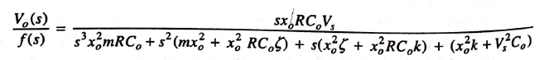
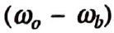
Cont…
The dynamic transfer function is given by
Where Co and xo are the initial values of x and C
Where S can be replaced by jω , where ω is the input circular frequency
Frequency response of this shows a flat response up to a frequency
at which a resonance occurs and range is obviously specified by the same.
Also below the response is not constant.
Hence the frequency
In case of generating action, along with bias Vs , a sinusoidal input voltage is also applied.
So that the diaphragm undergoes electrostatic vibration.

Slide 70
Photoelectric Elements
https://www.youtube.com/watch?v=P33-CQlwKLQ -photo electric transducer|Photoelectric working|Animation

Slide 71
Piezoelectric elements
Piezoelectricity is the ability of certain crystals to produce a voltage when subjected to mechanical stress (the substance is squeezed or stretched)
Conversely, a mechanical deformation (the substance shrinks or expands) is produced when an electric field is applied- “reverse piezoelectric effect” ...
https://www.slideshare.net/iamaproudindian/44-azeem
https://www.teachengineering.org/activities/view/uoh_piezo_lesson01_activity1 -Building a Piezoelectric Generator

Slide 72
Cont…
Crystals of certain classes are said to show piezoelectric effect which essentially means electric polarization produced by mechanical strain in the crystals. Such a polarization is believed to occur because of asymmetric crystal structure.
The effect is reversible in the sense that a strain may be produced in the crystal by electrically polarizing it using an external source .
While the mechanical input to electrical output form is used in developing transducers extensively, the reverse effect is used in many modem gadgets such as sonar systems, ultrasonic non-destructive test equipment, ultrasonic flowmeters, pump for inkjet printers, and so on.

Slide 73
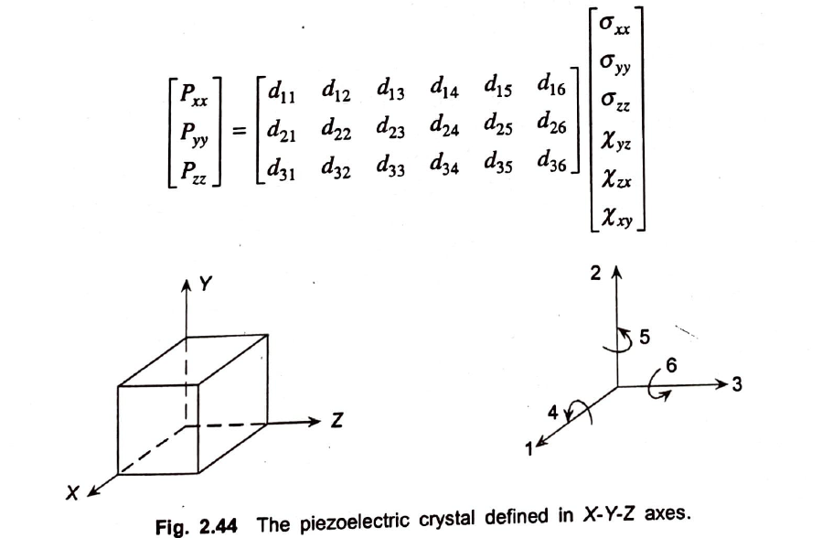
Cont…
Also a piezoelectric crystal is represented by a · set of three Cartesian coordinates so that the
polarization P can be represented in the vector form as
However, Pxx, Pyy, Pzz are again related to the stresses, axial and shear, σ and X in terms of axes-dependent coefficients caned d-constants of the crystal. With the axial and shear axe as shown in figure with reference to the crystal axes X-Y-Z, we obtain

Slide 74
Cont…
The d-constants are defined as:
dij = Charge generated in direction i/ force applied in direction j
=Qi / fj
The reverse effect d-coefficients are similarly defined as
dij = Strain in direction i/ field applied in direction j
= ε / E expressed as (m/m) / (V/m)
Once other coefficient which is of importance in practical design is the g-coefficient and its related to the d-coefficient by the dielectric constant of the material.

Slide 75
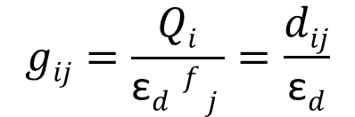
Cont…
It is defined as the voltage gradient or field in the crystal per unit pressure imparted to it.
Maintaining the direction as before, it can be shown that
The third coefficient h-coefficient is defined as the voltage gradient per unit strain which also appears to be the reciprocal of dij.
The h coefficient is easily obtained by g-coefficient by multiplying it with young’s modulus in the appropriate direction.

Slide 76
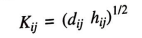
Cont…
Crystals of various uses are characterized by coupling coefficient which actually is a measure of the efficiency of the crystal as energy converter.
The numerical value of coupling coefficient is given by
The value of d11 for
- quartz is 2.3x10⁻¹² coulombs/N
- dielectric constant is 4.06x10⁻¹¹ F/m.
- g₁₁ is 56X10⁻³ (V/m)/(N/m2)

Slide 77
Piezoelectric materials
Materials are divided into 2 groups:
Occur naturally such as Quartz, Rochelle salt NaKC₄H₄O₆, 4H₂O, tourmaline
those produced synthetically such as lithium sulphate (LS), NH₄H₂PO₄ or ammonium dihydrogen Phosphate (ADP), BaTiO₃ or barium titanate (BT).
Barium titanate is actually a ferroelectric ceramic and requires to be polarized before use.
Besides, there are certain polymer films which also exhibit the piezoelectric property.

Slide 78
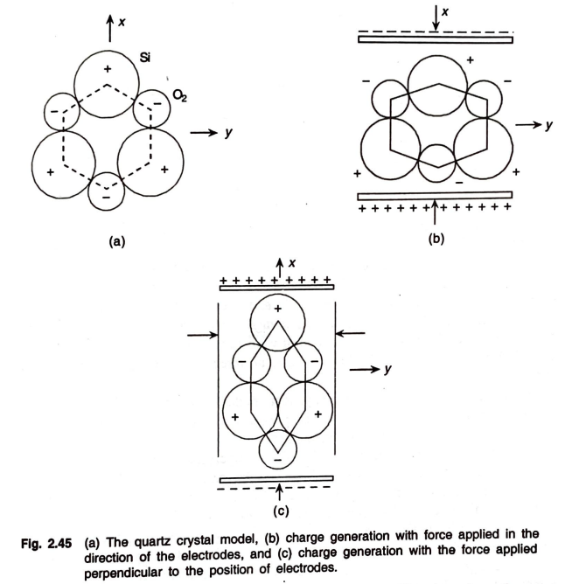

Slide 79
The material properties that are relevant to the piezoelectric sensors are
(i) dielectric constant,
(ii) d-coefficients (xx, say),
(iii) resistivity (specifically, volume resistivity is considered),
(iv) Young's modulus,
(v) humidity range (since above or below this range large absorption of moisture occurs changing volume resistivity
and performance characteristics),
(vi) temperature range, and
(vii) density.

Slide 80
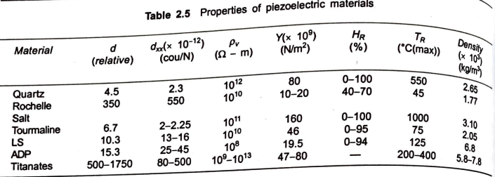
A comparative study of these properties is made in Table

Slide 81
Inspite of some deficiencies such as
low mechanical strength,
limited humidity and temperature range,
large hysteresis, and
fatigue,
Rochelle salt is often used in microphones also in gramophone pickups because of high shear sensitivity and peimittivity.
Tourmaline has poor sensitivity (dxx = 2-2.5) and is costly. It is, therefore, rarely used as a sensor of this type. But it has two specific advantages-
(i) it has a long, perhaps the longest, temperature range
(ii) it is the only naturally occurring variety that shows large volume expander mode capability, that is, with high force in all three directions it gives a large d-value in x-x direction.

Slide 82
Lithium Sulphate is good in volume-expander mode but ammonium dihydrogen phosphate is used quite extensively for acceleration and pressure sensing purposes although it has low permittivity. It can also be used in twisting applications.
Barium titanate (BaTiO3)-a polycrystalline ceramic has high εd and with induced polarization is very conveniently used in many transducers.
Ferroelectric materials can be analyzed analogous to the ferromagnetic ones and its polarization is effectively explained with the help of the 'domain' structure.
The material is assumed to consist of 'zones' with spontaneous polarization (for example, Weiss zones in ferromagnetic) which can be partially oriented by the application of external electric field.

Slide 83
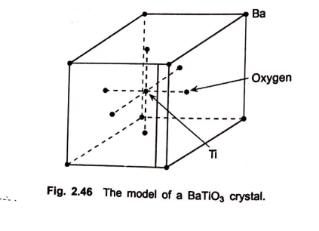
Cont…
A barium titanate crystal is modelled as shown in figure

Slide 84
For transducers, Lead Zirconate titanate has been found to be more suitable than the simple ones suggested previously.
Lead zirconate titanate is a solid solution of lead titanate and lead zirconate which is only 10-60 mole percent of the former.
Depending on the amount of lead zirconate and also on processing techniques, values of d-coefficients differ greatly, the Curie point being pushed up in almost all the cases from 200° to 300°-350°C.
Another composition consists of lead actaniobate which has the highest Curie point.
The dielectric constant, d-coefficients, and dissipation in a ferroelectric ceramic change with temperature.

Slide 85

Cont…
The nature of such changes are shown in relative response plots in Figure.

Slide 86

Cont…
These can be compared with those of quartz, specially the variation of d-coefficients and εd as shown in figure

Slide 87

Titanates are synthetically produced by pressure, film-casting or extrusion, and finally sintering-the ohmic contacts are obtained by silver or palladium coating on which soldering of lead-wires can he done before polarization.
Polarization is usually affected at a voltage, of 2 KV/mm and is kept for a few minutes depending on the material.
Considering quartz sensor of thickness t obtained by cutting perpendicular to its x-axis, two faces which have same areas (alpha each) and are perpendicular to axis are metalized.
Consider force f _{x} in x direction
Charge Q _{x}

Slide 88




Cont…
Capacitance C _{x} is given by
Voltage V _{x}
For a crystal of dimension as shown in figure, force f _{y} in y direction and the charge in perpendicular to x-direction is given by,

Slide 89



However, for quartz, all the d-coefficients given in below Equation are not finite nonzero values. In fact, the d-matrix for quartz is given as
The Q _{x} equation is modified as
Voltage V _{s}

Slide 90
Deformation modes and multimorphs
Piezoelectric sensors can produce outputs in the form of charge or voltage with force, acceleration, velocity (as displacement) and deformation (in crystals)
The deformation are of different types depending on application of input, accordingly number of modes are listed:
TEM (Thickness Expander Mode)
LEM (Length Expander Mode)
TSM (Thickness Shear Mode)
FSM (Face Shear Mode)
VEM (Volume Expander Mode)
Note: Shear stress, force tending to cause deformation of a material by slippage along a plane or planes parallel to the imposed stress. Shear stress may occur in solids or liquids; in the latter it is related to fluid viscosity.

Slide 91

Deformation modes

Slide 92
Deformation modes and multimorphs
Bimorphs :Instead of a single element sensor, it is possible to cement together two such elements as in a sandwich to obtain larger (ideally double) output called bimorphs.
Can be obtained by series sandwiching or by parallel arrangement
Multimorphs: If more than two elements are connected then they are called as multimorphs
In figure, polarization of two plates with respect to each other is different so that the parallel or series arrangement can be achieved.

Slide 93

Multimorphs

Slide 94

Ultrasonic Sensors
Ultrasonic sensors work by emitting sound waves at a frequency too high for humans to hear. They then wait for the sound to be reflected back, calculating distance based on the time required. This is similar to how radar measures the time it takes a radio wave to return after hitting an object

Slide 95
Ultrasonic Sensors
https://www.youtube.com/watch?v=vf2lW4LkmMQ - Ultrasonic sensor working principle
https://www.youtube.com/watch?v=JNQAH3VMFTU - Ultrasonic sensors – the alternative for difficult surfaces

Slide 96
Calculation of Sensitivity
Sensitivity is an important parameter to describe the electro-acoustic transducer energy conversion efficiency, and is a key indicator of transducer performance.
Sensitivity is simply defined as the ratio of an output quantity to an input quantity.
For an ultrasonic transducer characterized as a two-port network, there are the mechanical quantities of force and velocity (F, v) at the acoustic port and quantities of voltage and current (V, I) at the electrical port.
Since an ultrasonic transducer can be used as either a transmitter or a receiver, there are a variety of sensitivities that can be defined from these quantities

Slide 97

Cont…
The sensitivity is measured based on reciprocity and pulse-echo methods.
One transducer always used as receiving. Two another transducers were used sequentially as transmitters. The radiating sensitivities of these transducers were compared with each other.
The sensitivity in logarithmic units can be written as
Where, Vin – voltage applied to transmitting transducer
Vout – amplitude of voltage recorded at receiving transducer.

Slide 98

How capacitor microphone works?
The vast majority of capacitor microphones works by which, both 'true' DC-polarized condensers and back-electret models that are based around a metal-covered plastic diaphragm.
Gold evaporated or sputtered onto mylar is a popular combination, the resultant diaphragm membrane being thinner than a human hair.
This diaphragm is supported in front of a metal backplate, and these two conductive 'plates' form a simple capacitor — a device which can be used to store electrical charge.
https://www.youtube.com/watch?v=ekIYaHgzt5c -Capacitive transducer
https://www.youtube.com/watch?v=PE6Qn4ZiEyo-A Quick Guide to Microphones

Slide 99

Role of Capacitor in microphone
The amount of charge that can be stored is proportional (amongst other things) to the distance between the two plates.
Consequently, most capacitor microphones work by detecting the minuscule changes in stored charge which occur when the diaphragm moves relative to the backplate in response to passing sound waves.
The stored charge can be generated in a couple of different ways: either by using a relatively high DC polarization voltage, usually derived from phantom power; or by using a permanently charged film fixed to the backplate of the mic (the so called 'back electret' design).

Slide 100
In both cases, it is vital that the stored charge doesn't leak away, so the audio output circuitry has to present an extremely high impedance.
Thus all capacitor microphones incorporate a suitable impedance-matching preamplifier very close to the capsule, based either on solid-state FETs or valves.
The aim is to present an extremely high input impedance to the capsule, but a very low output impedance to the microphone cable.
Regardless of the way in which the stored charge is generated, both kinds of capacitor microphone obviously require power for the internal impedance-matching preamp.
This is usually obtained from phantom power again, but some mics can be operated from an internal battery instead, and valve microphones are usually powered from a dedicated mains PSU.

Slide 101
Microphone Responses and Measurements
Microphones have various properties that determine how they interact with sound.
There are five key properties to consider, including:
Frequency Response
Transient Response
Self-Noise
Maximum Sound Pressure Level
Dynamic Range

Slide 102
Frequency Response
The frequency response is the output level or sensitivity of a microphone over its operating range from the lowest to highest frequency.
A frequency response curve is a graphical representation of how a microphone will respond in the audio spectrum and so, how it will affect a signal’s overall sound timbre.
On a frequency response curve graph, the x-axis represents the signals measured frequency and relative response in decibels (dB) on the y-axis.

Slide 103

Cont…
Microphone manufacturers list the frequency response, such as 20-20,000 Hz, and usually provide a frequency response curve graph.

Slide 104
A microphone that has a flat frequency response produces equal output at all frequencies and is known as a flat response microphone. On the graph, the curve will be drawn as a flat line.
Flat response microphones are usually desirable for recording natural instruments such as a piano or acoustic guitar.
A microphone that has a varied frequency response produces a differing output of frequencies and is known as a shaped response microphone. On the graph, the curve will contain peaks and troughs.
A shaped response microphone is designed to enhance or detract certain applications. For example, a microphone may have a peak around 5 kHz to increase the presence of a vocal.
Shaped response microphones are especially useful for reducing pickup of unwanted sound and noise outside the frequency range of an instrument.

Slide 105


Slide 106

Photoelectric Elements
What’s Phtoto electric effect?
It is the emission of electrons from matter upon the absorption of electromagnetic radiation, such as ultraviolet radiation or x-rays.-refers to the emission, or ejection, of electrons from the surface of, generally, a metal in response to incident light.

Slide 107
Applications of photoelectric transducer
The Photomultiplier Tube
Photoconductive Cells or Photocells the electrical resistance of the materials varies with the amount of light striking.
The Photovoltaic Cell or solar cell- produce an electrical current when connected to the load.

Slide 108
Ultrasonic Sensors
Piezoelectric effect of certain crystalline materials has been successfully utilized in ultrasound production and sensing
When a electric field is applied to the crystal it changes its shape. This property is utilized in generating acoustic or ultrasound wave
For transmitting such wave good medium and interfacing should be chosen.
Barium titanate (BaTiO3) matrial is chosen, but requires prior polarization
https://www.youtube.com/watch?v=vf2lW4LkmMQ - Ultrasonic sensor working principle
https://www.youtube.com/watch?v=JNQAH3VMFTU - Ultrasonic sensors – the alternative for difficult surfaces

Slide 109
Cont…
It consists of randomly oriented tiny piezoelectric crystallites which are properly oriented mostly by DC polling field of several thousand volts per cm and the material is cooled through Curie temperature.
A strong piezoelectric effect has been observed in compounds such as PbZrO3-PbTiO3 called PZT materials.
Piezoelectric transducers can generate continuous wave ultrasound or pulsed ultrasound latter being used in SONAR or other similar systems.
Ultrasonic piezocrystals operate in the range 0f 0.5-10 MHz.
They are directly attached to the transmittmg medium or are separated by a small distance which is filled with coupling materials of suitable acoustic properties.
Typical couplants at low temperatures are water, grease, and petrojelly and for higher temperatures special polymer couplants may be used.

Slide 110
Cont…
For continuous wave operation, the sensor is energized by a tuned oscillator while for pulsed application 'relaxation' oscillators are used to charge a capacitor which is discharged across the sensor.
Analytical models describing the interactions of electrical and mechanical phenomena in piezoelectric media have been proposed but found to be inadequate for the design of piezoelectric transducers with realistic geometries and parameters of the material.

